Slide 1
Which is the Better
By: Irvin Mull
Senior, Economics & Political Science
Howard University

Slide 2
Question
Are Minorities Better Off at Minority Serving Institutions or PWIs?

Slide 3
Why is it Important?

Slide 4
Data Sources
U.S. Dept. of Education Scorecard Data
7, 804 Observations or Colleges and Universities
Accredited Colleges and Universities
1,728 Variables
Demographics
Income, Etc…
The College Scorecard
2015 Scorecard Redesign
Readily Accessible Database
User Friendly
Important Notes
Vanderbilt Professor Released Dataset in R

Slide 5
Limitations of Scope
Qualitative
Quantitative
Quality of Program
How Students Feel?
Curriculum
Reasons
Opinions
Motivations
Future Earnings
Income
Returnings to Education

Slide 6
Data Sources Cont.…
Collection of Data
FAFSA (Free Application For Federal Student Aid)
US Treasury Department
NSLDS (National Student Loan Data System)
US Dept. of Education
Composite of 2014-2015 Cohort
Undergraduates, Graduate, and Alumni
Data is Panel
2014-2015 Cross Section
Unit of Observation
College Level
Unique Identifier

Slide 7
Data Issues

Slide 8
Minority Identification
Historically Black Colleges and Universities (HBCUs)
Prominently Black Institutions (PBI)
Hispanic Serving Institutions (HSI)
Native American Serving Non-Tribal (NANTI)
Asian American Native American Pacific Islander (AANAPII)
Tribal

Slide 9
Important Variables
Avg. Family Income
Graduate Earnings 1yr, 6yr, 10yr
Disaggreated by Subgroups
Cost
Avg. Debt
Pell Grant, Loan Students,
Avg. Loan Amount
Standard Demographic Information
Race, Age, Sex, etc…

Slide 10
Mean Pell Grant Debt
HBCU-$17,780 *Max 27,000
PBI- $8,340
HIS- $9,484
ANNHI-12,240
NANTI-10,470
TRIBAL-9,587
PWI-12,550 * Max 41,00

Slide 11
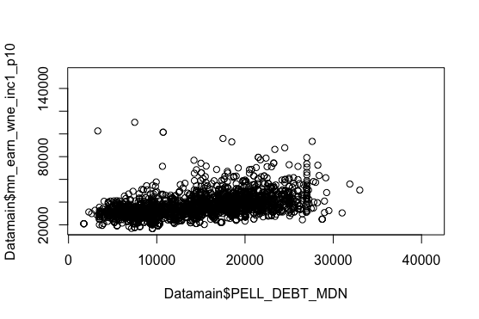
Correlation

Slide 12
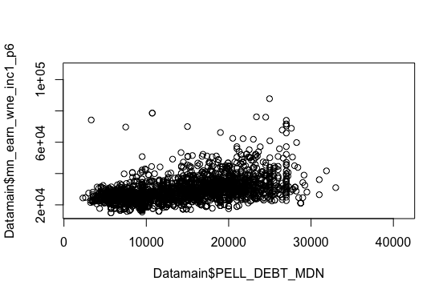
Correlation Cont.…

Slide 13
Next Steps
Determine Regression Equation
Regression Analysis
Future Earnings as Dependent Variable
Herinfindal Index as a Diversity Measure
Find a Way to Capture Qualitative Variables

